Slide 1
Lending Club Case Study
Exploratory Data Analysis
By Anish Dhondi

Slide 2
Contents
Problem Statement
Data Summary
Data Cleaning
Data conversions vs Derived
Columns Dropping/Imputing the Rows
Outliers
Univariate Analysis
Bivariate Analysis
Correlations
Conclusions

Slide 3
Problem Statement
Problem:
You work for a consumer finance company which specializes in lending various types of loans to urban customers. When the company receives a loan application, the company has to make a decision for loan approval based on the applicant’s profile. Two types of risks are associated with the bank’s decision:
Risk 1: If the applicant is likely to repay the loan, then not approving the loan results in a loss of business to the company.
Risk 2: If the applicant is not likely to repay the loan (i.e., likely to default), then approving the loan may lead to a financial loss for the company.
Objective:
Use Exploratory Data Analysis (EDA) to understand how consumer attributes and loan attributes influence the tendency of default.
Constraints:
When a person applies for a loan, there are two types of decisions that could be made by the company:
Loan accepted: If the company approves the loan, there are 3 possible scenarios:
Fully paid: Applicant has fully paid the loan (the principal and the interest rate).
Current: Applicant is in the process of paying the installments; the loan tenure has not yet been completed. These candidates are not labeled as ‘defaulted’.
Charged-off: Applicant has not paid the installments on time for a long period of time and has defaulted on the loan.
Loan rejected: The company rejected the loan because the candidate does not meet their requirements. Since the loan was rejected, there is no transactional history of those applicants with the company, and thus, this data is not available in this dataset.

Slide 4
Data Summary
Dataset: Loan.csv
Total Rows: 39,717
Total Columns: 111
Types of Attributes:
Loan Attributes: Information related to the loan itself (e.g., loan amount, interest rate, term, etc.)
Customer Attributes: Information about the customer (e.g., annual income, credit score, home ownership status, etc.)

Slide 5
Data Cleaning
Initial Dataset:
Rows: 39,717
Columns: 111
Steps Taken:
Rows with loan_status = 'current’:
1,140 rows removed as they don’t participate in the analysis.
Columns with All Null Values:
55 columns removed that had only null/blank values.
Unique Columns Removed:
‘url’ and ‘member_id’ were unique in nature and removed.
‘desc’ and ‘title’ were text/description fields and irrelevant to analysis.
Behavioral Data Columns:
21 columns related to behavioral data removed based on domain knowledge, as they are unavailable during loan approval.
Columns with Constant Values:
8 columns where the value was always ‘1’, indicating uniqueness, were dropped.
High Percentage of Missing Data:
2 columns with more than 50% missing data were removed.
Final Dataset:
Remaining Rows: 38,577
Remaining Columns: 20

Slide 6
Data Conversions vs Derived Columns
Data Conversions:
‘term’:
Trimmed additional string values and converted to int data type.
‘int_rate’:
Converted from string to int by trimming the '%' symbol.
‘loan_funded_amnt’ and ‘funded_amnt’:
Converted to float data type.
‘loan_amnt’, ‘funded_amnt’, ‘funded_amnt_inv’, ‘int_rate’, ‘dti’:
Rounded to two decimal points for consistency.
‘issue_d’:
Converted to a datetime data type for better analysis.
Derived Columns:
‘issue_year’ and ‘issue_month’:
Extracted from ‘issue_d’ for further analysis.
‘loan_amnt_b’, ‘annual_inc_b’, ‘int_rate_b’, ‘dti_b’:
Created bucketed columns from continuous data for more effective analysis.

Slide 7
Dropping/Inputing the rows
Dropping Rows:
Loan Status = ‘Current’:
Removed 1140 rows where loan_status = 'current', as they do not participate in the analysis.
Columns with Null/Blank Values:
Removed 55 columns where all rows contained null or blank values, as they didn’t contribute to the analysis.
Unique Columns (‘url’ and ‘member_id’):
Removed ‘url’ and ‘member_id’ since they are unique in nature and don’t contribute to the analysis.
Text/Description Columns (‘desc’ and ‘title’):
Dropped ‘desc’ and ‘title’ as they contain text descriptions and do not participate in the analysis.
Behavioral Data Columns:
Removed 21 behavioral data columns as they were not relevant to loan approval or analysis.
Columns with Constant Values:
Dropped 8 columns that had the same value (1) for all rows, indicating uniqueness and lack of variance.
Columns with >50% Missing Data:
Removed 2 columns with over 50% missing values as they would not provide meaningful insights.
Inputing Rows:
No row imputations were required as all columns were either dropped or kept after handling null values through the cleaning process.

Slide 8
Univariate Analysis

Slide 9
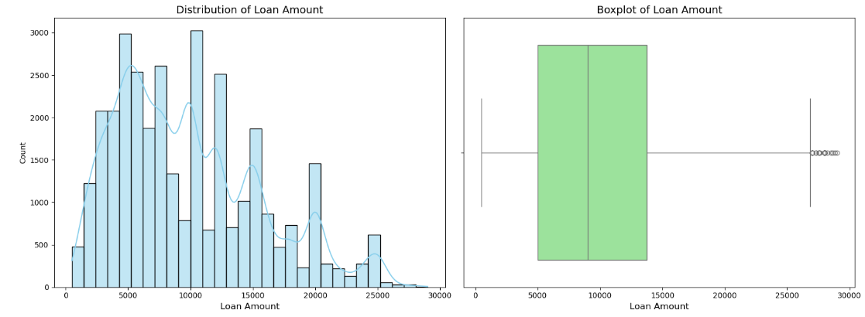
Loan Amount
Observation:
Most loan applications have loan amounts in the range of 5k to 14k, which indicates that the majority of borrowers prefer smaller loan amounts within this bracket.
2. The maximum loan amount applied for is around 29k, which stands out as an outlier compared to the general distribution of loan amounts.

Slide 10
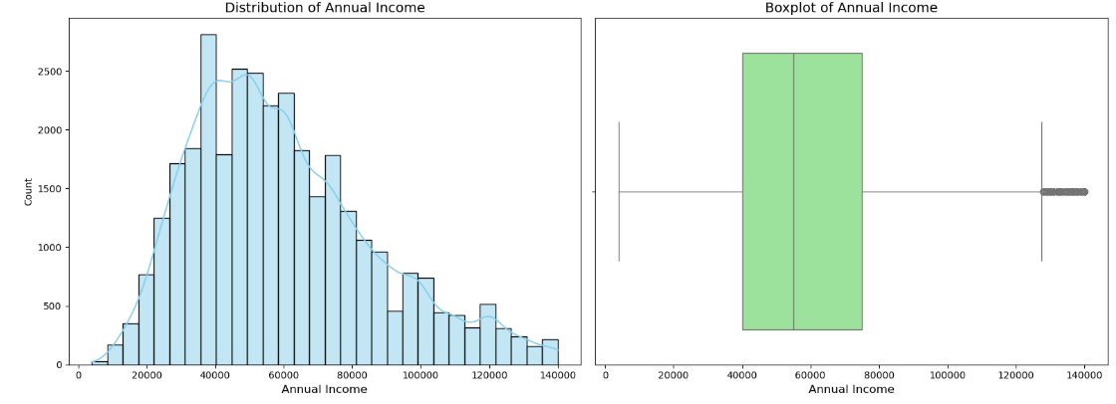
Annual Income
Observation:
1. The majority of applicants' annual incomes fall between 40k and 75k, as seen from the distribution.
2. The average annual income across all applicants is approximately $59,883, indicating a central tendency towards a middle-income range.
3. A larger proportion of applicants have incomes close to or slightly below the average, with a few outliers on both lower and higher ends of the spectrum.

Slide 11
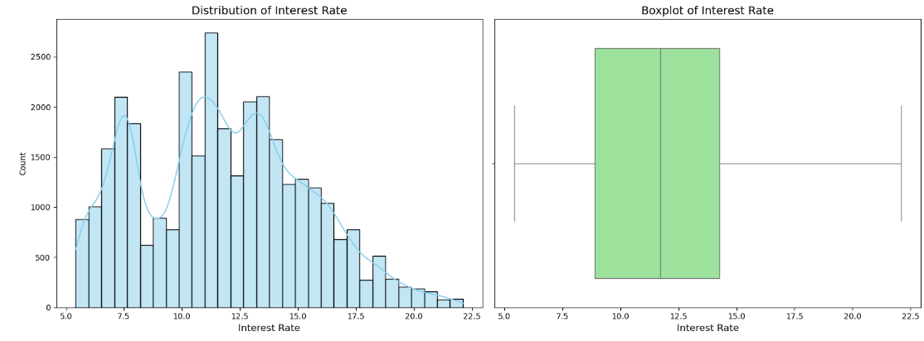
Interest Rate
Observation:
1. The majority of interest rates fall between 8.9% and 14.26%, with a mean interest rate of approximately 11.78%.
2. The minimum interest rate is 5.42%, while the highest interest rate recorded is 22.11%.

Slide 12
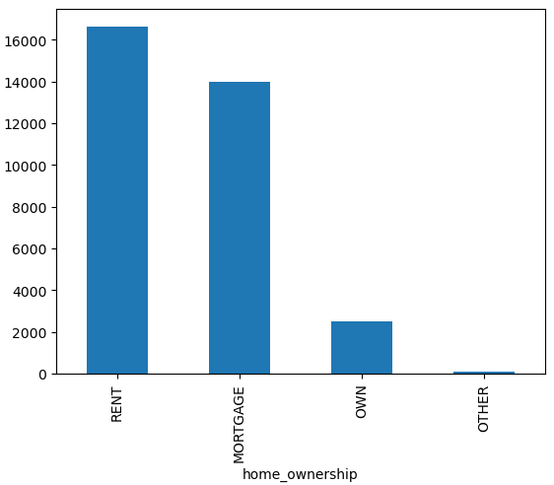
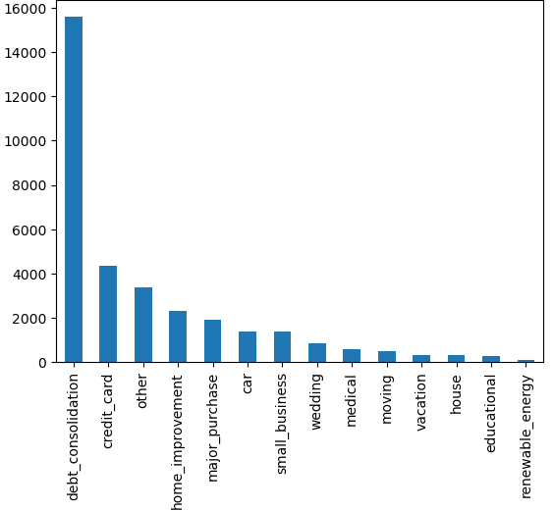
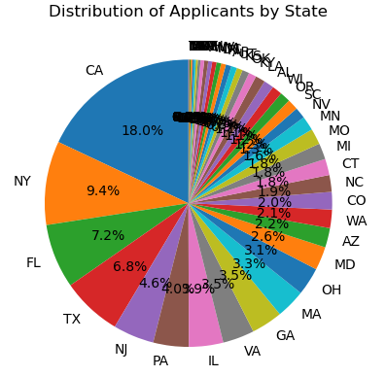
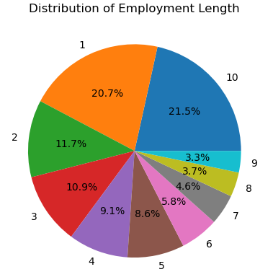
Univarients Analysis
Unordered & Ordered Categorical Variable Analysis
Observations:
Housing Status:
Majority of loan applicants are either living on Rent or on Mortgage.
Loan Purpose:
A significant portion of loan applicants are applying for debt consolidation.
Geographic Distribution:
The majority of loan applicants are from the state of California (CA).
Experience Level:
A large number of loan applicants have 10+ years of experience.

Slide 13
Bivariate Analysis

Slide 14
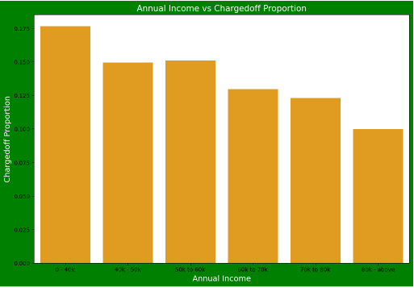
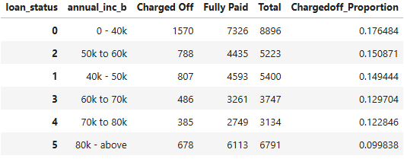
Annual income vs Charged Off
Observations:
1. The income range of 80k+ has lower chances of charge-off, indicating that higher-income individuals are less likely to default on their loans.
2. The income range of 0-40k has higher chances of charge-off, suggesting that individuals in this income bracket are more prone to default on their loans.
3. Overall, as the annual income increases, the charge-off proportion decreases, showing a negative correlation between income level and loan defaults.

Slide 15
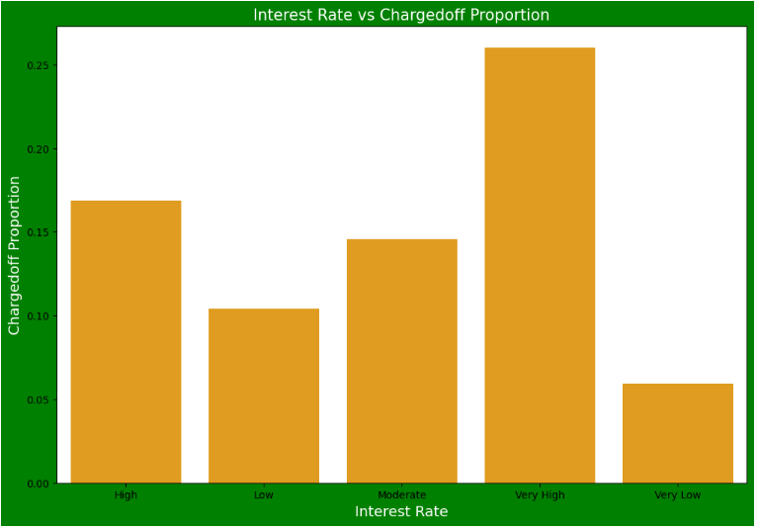
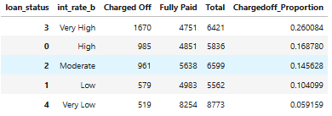
Interest Rate vs Charged off
Observation:
1. Loans with an interest rate of less than 10% (very low) have a significantly lower chance of being charged off, with the interest rates starting from a minimum of 5%.
2. Loans with interest rates higher than 16% (very high) show a higher proportion of charged-off loans compared to the other categories.
3. The charged-off proportion tends to increase as the interest rate rises, indicating a correlation between higher interest rates and higher loan defaults.

Slide 16
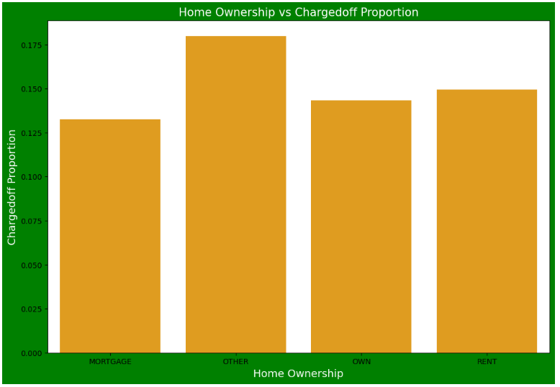
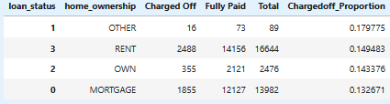
Home Ownership vs Charged off
Observation:
1. Individuals who do not own a home have a higher likelihood of loan defaults compared to those with home ownership.

Slide 17
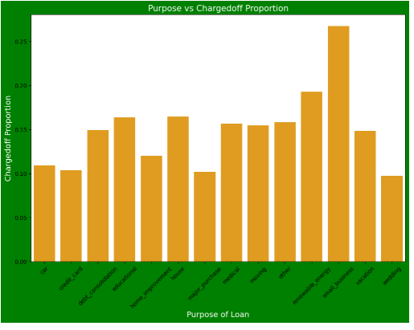
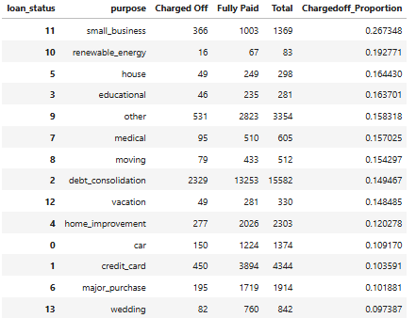
Purpose vs Charged Off
Observations:
1. Applicants who took loans for wedding purposes tend to have lower chances of loan defaults.
2. Applicants who borrowed for small business purposes exhibit higher chances of loan defaults.

Slide 18
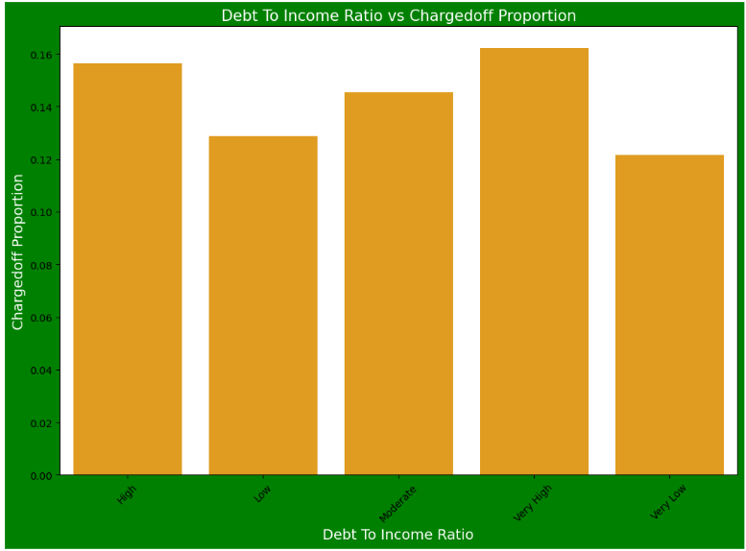

DTI Vs Charged off
Observations:
1. Higher Debt-to-Income (DTI) values are associated with a higher risk of loan defaults.
2. Lower DTI values indicate a lower probability of loan defaults.

Slide 19
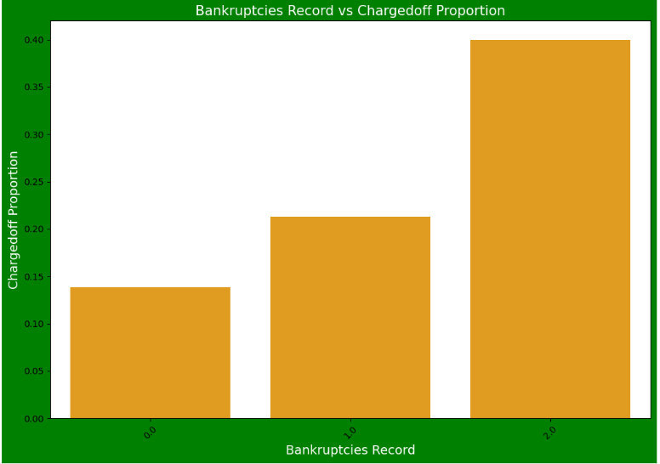
Bankruptcies Record vs Charged off
Observations:
1. Loan defaults are significantly higher among applicants with 2 bankruptcy records.
2. Applicants with no bankruptcy records (0) have a much lower risk of defaulting on their loans.
3. Generally, the fewer bankruptcy records an applicant has, the lower the risk of default.

Slide 20
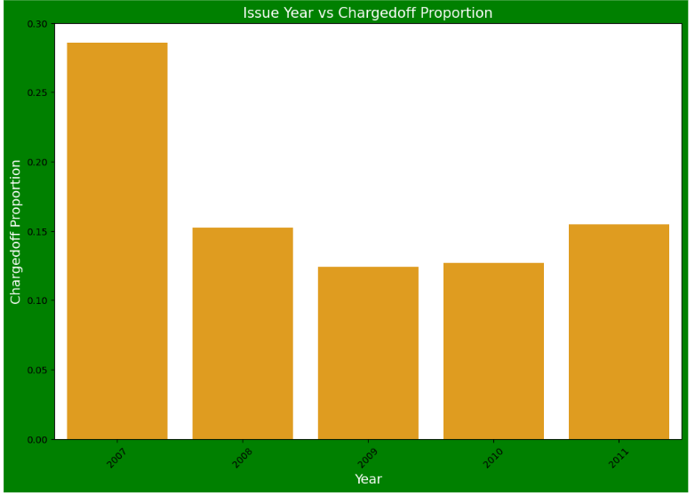
Issue Year vs Charged off
Observations:
1. Year 2007 has the highest proportion of loan defaults, indicating a higher risk of charge-offs in that year.
2. Year 2009 shows the lowest proportion of loan defaults, indicating a relatively better repayment behavior for loans issued that year.

Slide 21
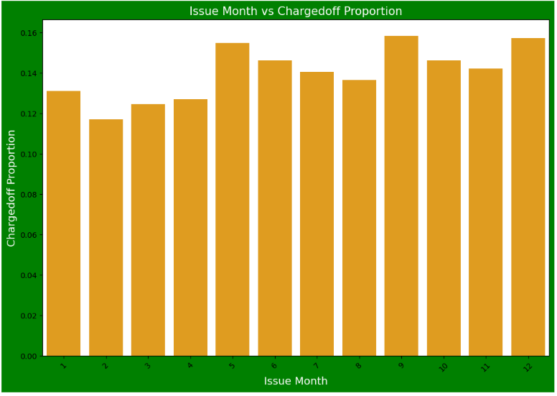
Issue Month Vs Charged off
Observations:
1. Loans issued in May, September, and December exhibit a higher number of loan defaults.
2. February is another month with a significant number of loan defaults.
3. A substantial portion of loan defaults originates from loans approved between September and December.

Slide 22
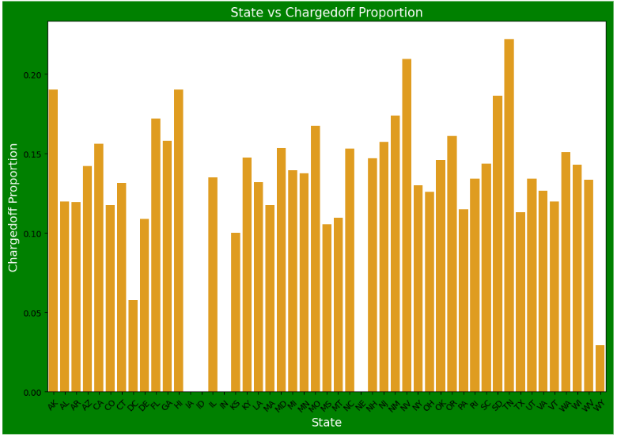
State vs Charged off
Observations:
1. DE States have the highest number of loan defaults.
2. CA (California) has the lowest number of loan defaults.

Slide 23
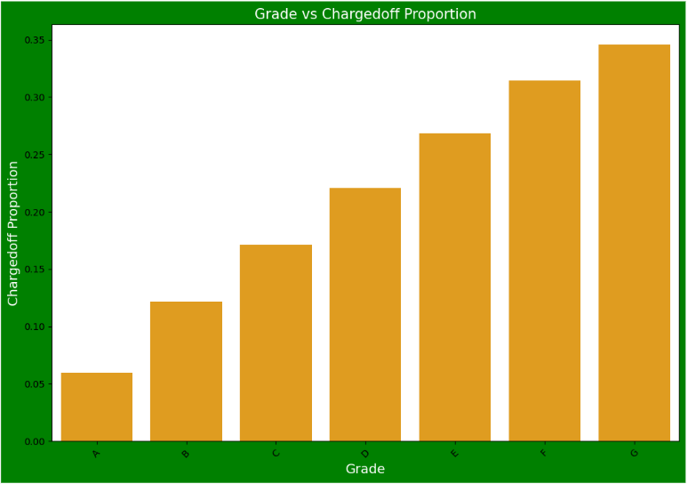
Grade vs ChargedOff
Observations:
1. Loan applicants with Grade G have the highest proportion of loan defaults (charged-off loans).
2. Loan applicants with Grade A exhibit the lowest proportion of loan defaults, indicating better loan repayment rates in this group.

Slide 24
Correlation

Slide 25
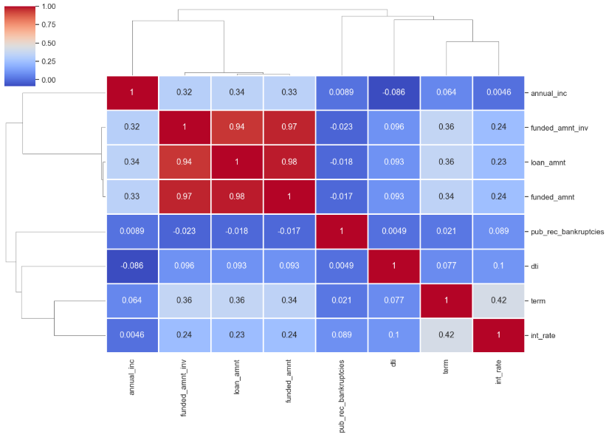
Correlations
Negative Correlations:
1. Loan Amount and Bankruptcies: Higher bankruptcies are associated with lower loan amounts.
2. Annual Income and Debt-to-Income Ratio: Higher income leads to a lower debt-to-income ratio.
Strong Positive Correlations:
1. Loan Term and Loan Amount: Longer loan terms are linked to higher loan amounts.
2. Loan Term and Interest Rate: Longer terms are associated with higher interest rates.
3. Annual Income and Loan Amount: Higher income corresponds to larger loan amounts.

Slide 26
Conclusions
Income:
Applicants with an income range of 0-20,000 are at the highest risk of loan defaults.
Interest Rates:
Loans with an interest rate above 16% have significantly higher chances of being charged off.
Home Ownership:
Non-homeowners are more likely to default on loans compared to those who own homes.
Loan Purpose:
Loans taken for small businesses exhibit the highest default rates compared to other loan purposes.
Debt-to-Income (DTI):
High DTI values correlate with a greater risk of loan defaults.
Credit History:
Applicants with a history of bankruptcies have a significantly higher probability of defaulting.
State-Level Defaults:
The state of Delaware (DE) records the highest proportion of loan defaults.
Loan Grades:
Applicants with loans in Grade G are the most likely to default, while Grade A has the least defaults.

Slide 27
THANK YOU

